Slide 1
PHP Programming with MySQL
Day 7

Slide 2
Connecting to MySQL with PHP
PHP has the ability to access and manipulate any database that is ODBC compliant
PHP includes functionality that allows you to work directly with different types of databases, without going through ODBC
PHP supports SQLite, database abstraction layer functions, and PEAR DB

Slide 3
Determining which MySQL Package to Use
The mysqli (MySQL Improved) package became available with PHP 5 and is designed to work with MySQL version 4.1.3 and later
Earlier versions must use the mysql package
The mysqli package is the object-oriented equivalent of the mysql package

Slide 4
Opening and Closing a MySQL Connection
Open a connection to a MySQL database server with the mysql_connect() function
The mysql_connect() function returns a positive integer if it connects to the database successfully or FALSE if it does not
Assign the return value from the mysql_connect() function to a variable that you can use to access the database in your script
The syntax for the mysql_connect() function is:
$connection = mysql_connect("host" [, "user", "password"]);
The host argument specifies the host name where your MySQL database server is installed
The user and password arguments specify a MySQL account name and password

Slide 5
Opening and Closing a MySQL Connection
The database connection is assigned to the $DBConnect variable
$DBConnect = mysql_connect("localhost", "dongosselin", "rosebud");
Close a database connection using the mysql_close() function
mysql_close($DBConnect);

Slide 6
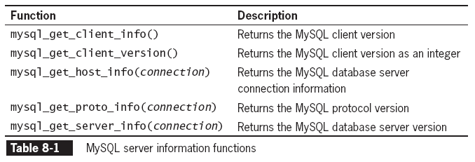
Opening and Closing a MySQL Connection

Slide 7
Reporting MySQL Errors
Reasons for not connecting to a database server include:
The database server is not running
Insufficient privileges to access the data source
Invalid username and/or password
The mysql_errno() function returns the error code from the last attempted MySQL function call or 0 if no error occurred
The mysql_errno() and mysql_error() functions return the results of the previous mysql*() function

Slide 8
Creating a Database
Use the mysql_create_db() function to create a new database
The basic syntax for the mysql_create_db() is:
$result = mysql_create_db( "dbname" [, connection]);
The mysql_create_db() returns a Boolean TRUE if successful or FALSE if there was an error

Slide 9
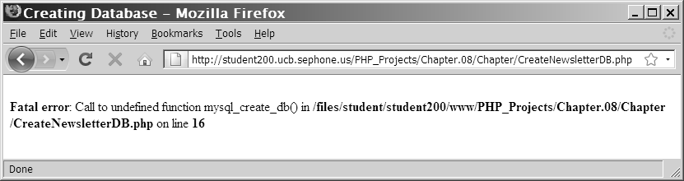
Creating a Database
Figure 8-2 Error message when the mysql_create_db() function is unavailable because of insufficient privileges

Slide 10
Selecting a Database
The syntax for the mysql_select_db() function is:
mysql_select_db(database [, connection]);
The function returns a value of TRUE if it successfully selects a database or FALSE if it does not
For security purposes, you may choose to use an include file to connect to the MySQL server and select a database

Slide 11
Deleting a Database
To delete a database, use the mysql_drop_db() function.
The format for the mysql_drop_db() function is:
$Result = mysql_drop_db("dbname" [, connection]);
The function returns a value of TRUE if it successfully drops a database or FALSE if it does not

Slide 12
Executing SQL Statements
Use the mysql_query() function to send SQL statements to MySQL
The syntax for the mysql_query() function is:
mysql_query(query [, connection]);
The mysql_query() function returns one of three values:
For SQL statements that do not return results (CREATE DATABASE and CREATE TABLE statements) it returns a value of TRUE if the statement executes successfully
For SQL statements that return results (SELECT and SHOW statements) the mysql_query() function returns a result pointer that represents the query results
A result pointer is a special type of variable that refers to the currently selected row in a resultset
The mysql_query() function returns a value of FALSE for any SQL statements that fail, regardless of whether they return results

Slide 13
Creating and Deleting Tables
Use the CREATE TABLE statement with the mysql_query() function to create a new table
Use the mysql_select_db() function before executing the CREATE TABLE statement to verify that you are in the right database.
$SQLstring = "CREATE TABLE drivers (name VARCHAR(100), "
. "emp_no SMALLINT, hire_date DATE, "
. "stop_date DATE)";
$QueryResult = @mysql_query($SQLstring, $DBConnect);
if ($QueryResult===FALSE) {
echo "<p>Unable to execute the query.</p>"
. "<p>Error code " . mysql_errno($DBConnect)
. ": " . mysql_error($DBConnect) . "</p>";
} else {
echo "<p>Successfully created the table.</p>";
}

Slide 14
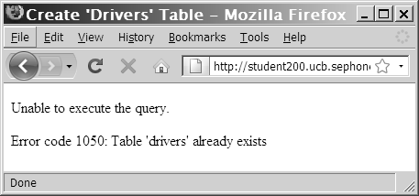
Creating and Deleting Tables
Figure 8-3 Error code and message that displays when you attempt to create a table that already exists

Slide 15
Creating and Deleting Tables
Use the SHOW TABLES LIKE command to prevent code from trying to create a table that already exists.
If the table does not exist, the mysql_num_rows()function will return a value of 0 rows
$TableName = "subscribers";
$SQLstring = "SHOW TABLES LIKE '$TableName'";
$QueryResult = mysql_query($SQLstring, $DBConnect);

Slide 16
Creating and Deleting Tables
To identify a field as a primary key in MySQL, include the PRIMARY KEY keywords when you define a field with the CREATE TABLE statement
The AUTO_INCREMENT keyword is often used with a primary key to generate a unique ID for each new row in a table
The NOT NULL keywords are often used with primary keys to require that a field include a value
To delete a table, use the DROP TABLE statement with the mysql_query() function

Slide 17
Adding, Deleting, and Updating Records
To add records to a table, use the INSERT and VALUES keywords with the mysql_query() function
To add multiple records to a database, use the LOAD DATA statement with the name of the local text file containing the records you want to add
To update records in a table, use the UPDATE statement

Slide 18
Adding, Deleting, and Updating Records
The UPDATE keyword specifies the name of the table to update
The SET keyword specifies the value to assign to the fields in the records that match the condition in the WHERE clause
To delete records in a table, use the DELETE statement with the mysql_query() function
If you omit the WHERE clause in the DELETE statement, all records in the table will be deleted!
MySQL can be configured in “safe mode” to prevent this from happening.

Slide 19
Exercise
Follow the instructions of Exercise 8-1 in the book (p. 487) to implement a MySQL based guest book.
Think of how you would improve the guest book program
Present your improvement proposals to the class.
Notes:
Should CREATE DATABASE and CREATE TABLE be part of the PHP script?
All-in-one page design.
Enhanced input validation.

Slide 20
Retrieving Records into an Indexed Array
The mysql_fetch_row() function returns the fields in the current row of a resultset into an indexed array and moves the result pointer to the next row
echo "<table width='100%‘ border='1'>";
echo "<tr><th>Make</th><th>Model</th>
<th>Price</th><th>Quantity</th></tr>";
$Row = mysql_fetch_row($QueryResult);
do {
echo "<tr><td>{$Row[0]}</td>";
echo "<td>{$Row[1]}</td>";
echo "<td align='right'>{$Row[2]}</td>";
echo "<td align='right'>{$Row[3]}</td></tr>";
$Row = mysql_fetch_row($QueryResult);
} while ($Row);

Slide 21
Using the mysql_affected_rows() Function
With queries that return results (SELECT queries), use the mysql_num_rows() function to find the number of records returned from the query
With queries that modify tables but do not return results (INSERT, UPDATE, and DELETE queries), use the mysql_affected_rows() function to determine the number of affected rows

Slide 22
Using the mysql_affected_rows() Function
$SQLstring = "UPDATE company_cars SET mileage=50112.3 WHERE license='AK-1234'";
$QueryResult = @mysql_query($SQLstring, $DBConnect);
if ($QueryResult === FALSE) {
echo "<p>Unable to execute the query.</p>"
. "<p>Error code " . mysql_errno($DBConnect)
. ": " . mysql_error($DBConnect) . "</p>";
} else {
echo "<p>Successfully updated "
. mysql_affected_rows($DBConnect) . " record(s).</p>";
}

Slide 23

Using the mysql_affected_rows() Function
Figure 8-5 Output of mysql_affected_rows() function for an UPDATE query

Slide 24
Using the mysql_info() Function
For queries that add or update records, or alter a table’s structure, use the mysql_info() function to return information about the query
The mysql_info() function returns the number of operations for various types of actions, depending on the type of query
The mysql_info() function returns information about the last query that was executed on the database connection

Slide 25
Using the mysql_info() Function
The mysql_info() function returns information about queries that match one of the following formats:
INSERT INTO...SELECT...
INSERT INTO...VALUES (...),(...),(...)
LOAD DATA INFILE ...
ALTER TABLE ...
UPDATE
For any queries that do not match one of these formats, the mysql_info() function returns an empty string

Slide 26
Using the mysql_info() Function
$SQLstring = "INSERT INTO company_cars " .
" (license, model_year, make, model, mileage) " .
" VALUES " .
" ('CPQ-894', 2011, 'Honda', 'Insight', 49.2), " .
" ('CPQ-895', 2011, 'Honda', 'Insight', 17.9), " .
" ('CPQ-896', 2011, 'Honda', 'Insight', 22.6)";
$QueryResult = @mysql_query($SQLstring, $DBConnect);
if ($QueryResult === FALSE) {
echo "<p>Unable to execute the query.</p>"
. "<p>Error code " . mysql_errno($DBConnect)
. ": " . mysql_error($DBConnect) . "</p>";
} else {
echo "<p>Successfully added the record.</p>";
echo "<p>" . mysql_info($DBConnect) . "</p>";
}

Slide 27
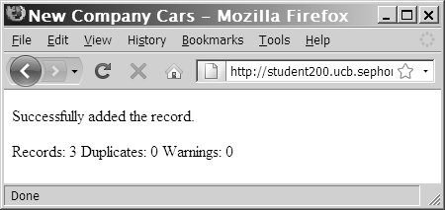
Using the mysql_info() Function
Figure 8-6 Output of mysql_info() function for an INSERT query that adds multiple records

Slide 28
Using the mysql_info() Function
The mysql_info() function also returns information for LOAD DATA queries
$SQLstring = "LOAD DATA INFILE 'company_cars.txt' INTO TABLE company_cars;";
$QueryResult = @mysql_query($SQLstring, $DBConnect);
if ($QueryResult === FALSE) {
echo "<p>Unable to execute the query.</p>"
. "<p>Error code " . mysql_errno($DBConnect)
. ": " . mysql_error($DBConnect) . "</p>";
} else {
echo "<p>Successfully added the record.</p>";
echo "<p>" . mysql_info($DBConnect) . "</p>";
}

Slide 29
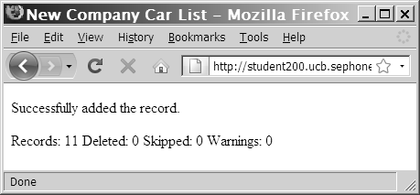
Using the mysql_info() Function
Figure 8-7 Output of mysql_info() function for a
LOAD DATA query

Slide 30
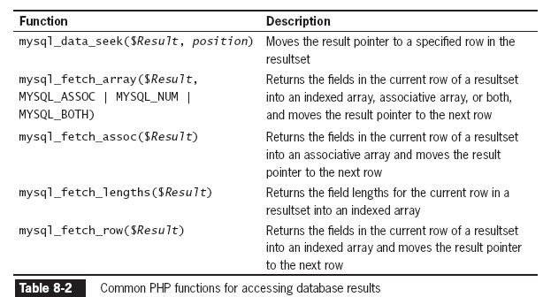
Working with Query Results

Slide 31
Retrieving Records into an Indexed Array
The mysql_fetch_row() function returns the fields in the current row of a result set into an indexed array and moves the result pointer to the next row
$SQLstring = "SELECT * FROM company_cars";
$QueryResult = @mysql_query($SQLstring, $DBConnect);
echo "<table width='100%' border='1'>\n";
echo "<tr><th>License</th><th>Make</th><th>Model</th>
<th>Mileage</th><th>Year</th></tr>\n";
while (($Row = mysql_fetch_row($QueryResult)) !== FALSE) {
echo "<tr><td>{$Row[0]}</td>";
echo "<td>{$Row[1]}</td>";
echo "<td>{$Row[2]}</td>";
echo "<td align='right'>{$Row[3]}</td>";
echo "<td>{$Row[4]}</td></tr>\n";
}
echo "</table>\n";

Slide 32
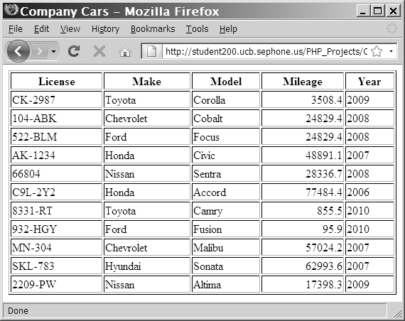
Retrieving Records into an Indexed Array
Figure 8-8 Output of the company_cars table in a Web Browser

Slide 33
Retrieving Records into an Associative Array
The mysql_fetch_assoc() function returns the fields in the current row of a resultset into an associative array and moves the result pointer to the next row
The difference between mysql_fetch_assoc() and mysql_fetch_row() is that instead of returning the fields into an indexed array, the mysql_fetch_assoc() function returns the fields into an associate array and uses each field name as the array key

Slide 34
Closing Query Results
When you are finished working with query results retrieved with the mysql_query() function, use the mysql_free_result() function to close the resultset
To close the resultset, pass to the mysql_free_result() function the variable containing the result pointer from the mysql_query() function

Slide 35
Accessing Query Result Information
The mysql_num_rows() function returns the number of rows in a query result
The mysql_num_fields() function returns the number of fields in a query result
Both functions accept a database connection variable as an argument

Slide 36
Accessing Query Result Information
$SQLstring = "SELECT * FROM company_cars";
$QueryResult = @mysql_query($SQLstring, $DBConnect);
if ($QueryResult === FALSE) {
echo "<p>Unable to execute the query.</p>"
. "<p>Error code " . mysql_errno($DBConnect)
. ": " . mysql_error($DBConnect) . "</p>";
} else {
echo "<p>Successfully executed the query.</p>";
}
$NumRows = mysql_num_rows($QueryResult);
$NumFields = mysql_num_fields($QueryResult);
if ($NumRows != 0 && $NumFields != 0) {
echo "<p>Your query returned " . mysql_num_rows($QueryResult) . " rows and "
. mysql_num_fields($QueryResult) . " fields.</p>";
} else {
echo "<p>Your query returned no results.</p>";
}
mysql_close($DBConnect);

Slide 37
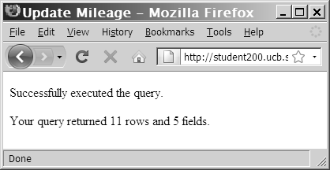
Accessing Query Result Information
Figure 8-10 Output of the number of rows and fields returned from a query

Slide 38
Summary
The mysql_connect() function opens a connection to a MySQL database server
The mysql_close() function closes a database connection
The mysql_errno() function returns the error code from the last attempted MySQL function call or zero if no error occurred
The mysql_error() function returns the error message from the last attempted MySQL function call or an empty string if no error occurred
You use the mysql_create_db() function to create a new database
The mysql_select_db() function selects a database

Slide 39
Summary
You use the mysql_drop_db() function to delete a database
The mysql_query() function sends SQL statements to MySQL
A result pointer is a special type of variable that refers to the currently selected row in a resultset
You use the CREATE TABLE statement with the mysql_query() function to create a table
The PRIMARY KEY clause indicates a field or fields that will be used as a referential index for the table
The AUTO_INCREMENT clause creates a field that is automatically updated with the next sequential value for that column
The NOT NULL clause creates a field that must contain data
You use the DROP TABLE statement with the mysql_query() function to delete a table

Slide 40
Summary
You use the LOAD DATA statement and the mysql_query() function with a local text file to add multiple records to a database
You use the UPDATE statement with the mysql_query() function to update records in a table
You use the DELETE statement with the mysql_query() function to delete records from a table

Slide 41
Summary
The mysql_info() function returns the number of operations for various types of actions, depending on the type of query.
The mysql_fetch_row() function returns the fields in the current row of a resultset into an indexed array and moves the result pointer to the next row.
The mysql_fetch_assoc() function returns the fields in the current row of a resultset into an associative array and moves the result pointer to the next row
The mysql_free_result() function closes a resultset
The mysql_num_rows() function returns the number of rows in a query result, and the mysql_num_fields() function returns the number of fields in a query result
With queries that return results, such as SELECT queries, you can use the mysql_num_rows() function to find the number of records returned from the query

Slide 42
Exercise
Create a web page that stores class surveys in a MySQL database. Include fields for date and time of the class, class name and number, instructor’s name and any other information you think is important.
Consider including groups of radio buttons that allow the user to rate the class, the instructor and school.
Include a “View Past Survey Results” button on the main page that displays a list of past survey results.
Test the survey application in desktop and mobile viewports.

